Slide 1

Energy Consumption Prediction of Home Appliances using Ensemble Techniques
PROJECT GUIDE:
Mr. K. SIVA KUMAR M.E
CSE DEPT
BEC
Presented by:
S. LAKSHMI SUPRAJA DEVI -Y20ACS571
S. LEELA KRISHNA -Y20ACS552
SK. MASTANVALI -L21ACS418
P. NAVEEN KUMAR REDDY -Y20ACS526

Slide 2
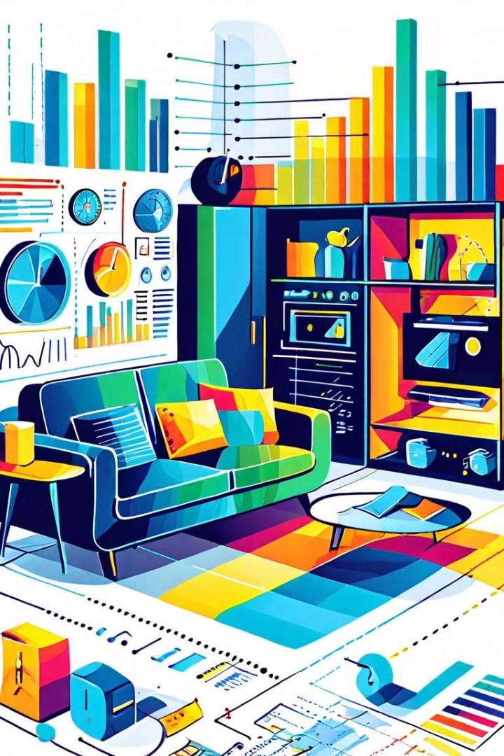
Abstract
This study analyzes household appliance energy consumption, focusing on factors like design, technology, user behavior, and regulatory policies. It aims to identify strategies for optimizing energy efficiency. Results highlight the impact of these factors and underscore the importance of consumer awareness for reducing energy footprints and achieving long-term savings.

Slide 3
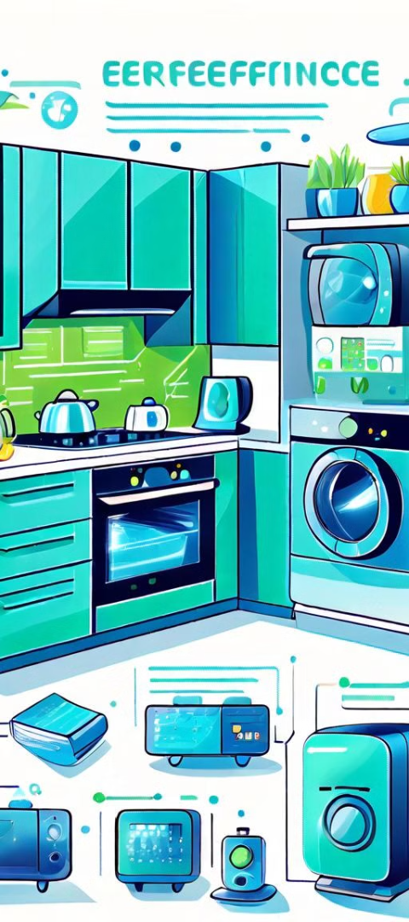
Existing System
Utilizes a random k-label joints approach for analyzing household appliance energy consumption.
Selection of k-label joints is random, combining different features or variables for modeling and prediction.
Performance is suboptimal due to the random nature of joint selection.
Fails to accurately capture intricate relationships and dependencies within the data. Predictive accuracy is limited.
Ineffectiveness in identifying key factors influencing energy consumption. Lack of systematic approach in joint selection hinders. Generalization to unseen data. Adaptability to changing conditions. Overall, while attempting to leverage random k-label joints for energy analysis, the system's performance is unsatisfactory.

Slide 4
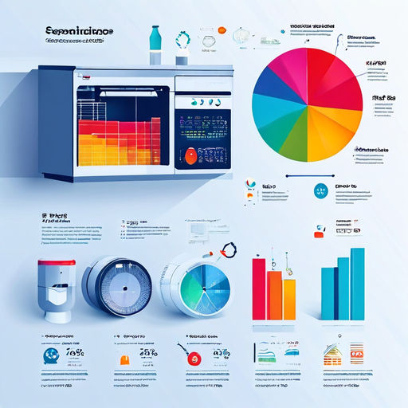
Proposed System
The proposed system employs Random Forest, a powerful ensemble learning algorithm capable of handling large datasets with high dimensionality. By training on historical energy consumption data, weather conditions, time-of-day patterns, and user behavior, the Random Forest model learns to predict future appliance energy usage with high accuracy.
Random Forest constructs an ensemble of decision trees, where each tree is trained on a random subset of the training data and a random subset of the input features. This randomness helps prevent overfitting and improves generalization.
Once trained, the Random Forest model can be used to make predictions on new data. For energy prediction, the model takes as input the relevant features (e.g., current weather conditions, time of day) and outputs the predicted energy consumption for the specified time period and appliance.

Slide 5
Design
Dataset
Data Preprocessing
Training Model using RandomForestRegressor
Testing
Prediction

Slide 6
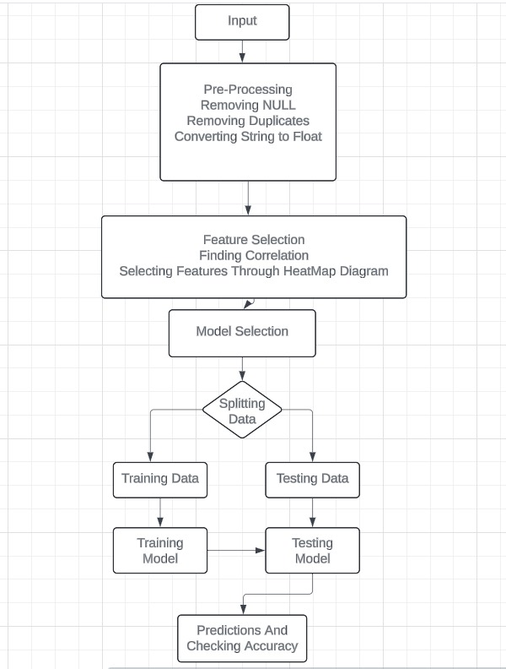
Implementation

Slide 7
Implementation
Data Collection
Collecting comprehensive data on household energy consumption, including appliance type, efficiency ratings, usage patterns, and environmental conditions.
Data Preprocessing
Preprocessing collected data, handling missing values, inconsistencies, and formatting for analysis.
Model Training and Evaluation
Training ensemble models (Random Forest) on preprocessed data, rigorously evaluating performance for accurate predictions.
Deployment and Integration
Deploying trained models with energy systems or user applications for real-time consumption predictions and recommendations.

Slide 8
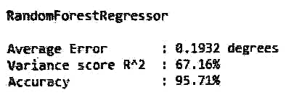

Result
Predictive Accuracy
The Random Forest model achieved an average error of 0.1932 degrees, a variance score (R^2) of 67.16%, and an accuracy of 95.71%.

Slide 9

Conclusion
Outperformed Existing System
The proposed ensemble-based approach demonstrated superior predictive accuracy and efficiency compared to the existing random k-label joints approach.
Importance of Ensemble Techniques
The findings emphasize the value of ensemble machine learning techniques in optimizing energy consumption and enabling significant energy savings.
Future Research Opportunities
Continued exploration of fine-tuning model parameters and investigating additional ensemble techniques to further enhance the system's performance.

Slide 10

References
"Energy Consumption Prediction using Machine Learning Techniques: A Review“ by Ahmed Al-Abdulkareem, 2022.
"A Review of Machine Learning and Deep Learning Techniques for Energy Consumption Prediction“ by Mohammad Al-Anazi, 2021.
"Energy Consumption Prediction in Smart Buildings: A Review of Machine Learning Techniques“ by Ali Al-Anazi, 2022.

Slide 11

Thank You

